Slide 1
Introduction to R and RStudio
Ozayr Mohammed | Alexander Lawless
ozayr.mohammed@nhs.net | alexander.lawless1@nhs.net
Healthcare Analysts | The Strategy Unit

Slide 2

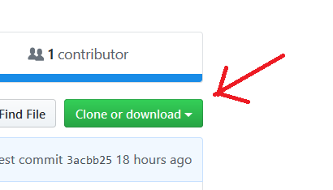
Materials Please download course materials at: https://github.com/nhs-r-community/intro_r

Slide 3
About the trainers
Healthcare Analysts
Utilisation rates of different services across an area.
Monthly reports of referrals to a service
Effects of Pandemic and lockdowns on services

Slide 4
Agenda
“Adjusting the seat and mirrors”:
Intro + Setup + Import data
Graphics with ggplot2
--------- 12:30 Lunch -----------
Data wrangling with dplyr
Data wrangling with dplyr cont.
Demos and future learning
11:00 Break
14:30 Break

Slide 5
Course Aims
To show you some of the possibilities:

Slide 6
elegant Graphics

Slide 7
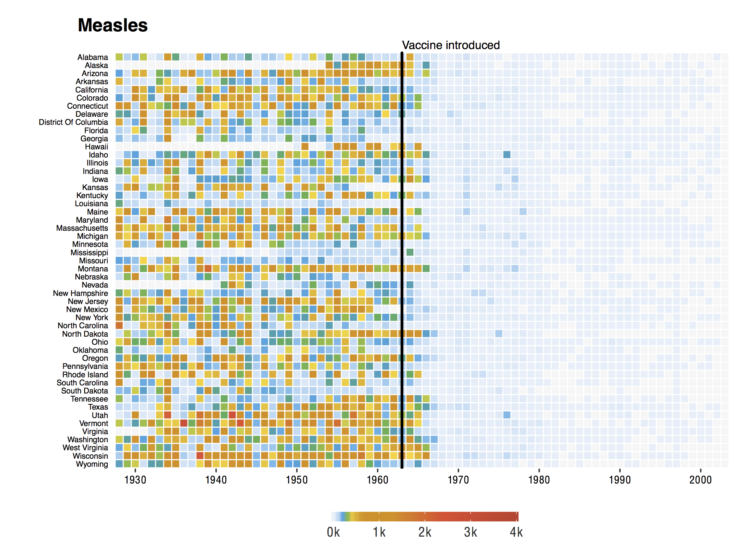
https://benjaminlmoore.wordpress.com/tag/ggplot2/

Slide 8
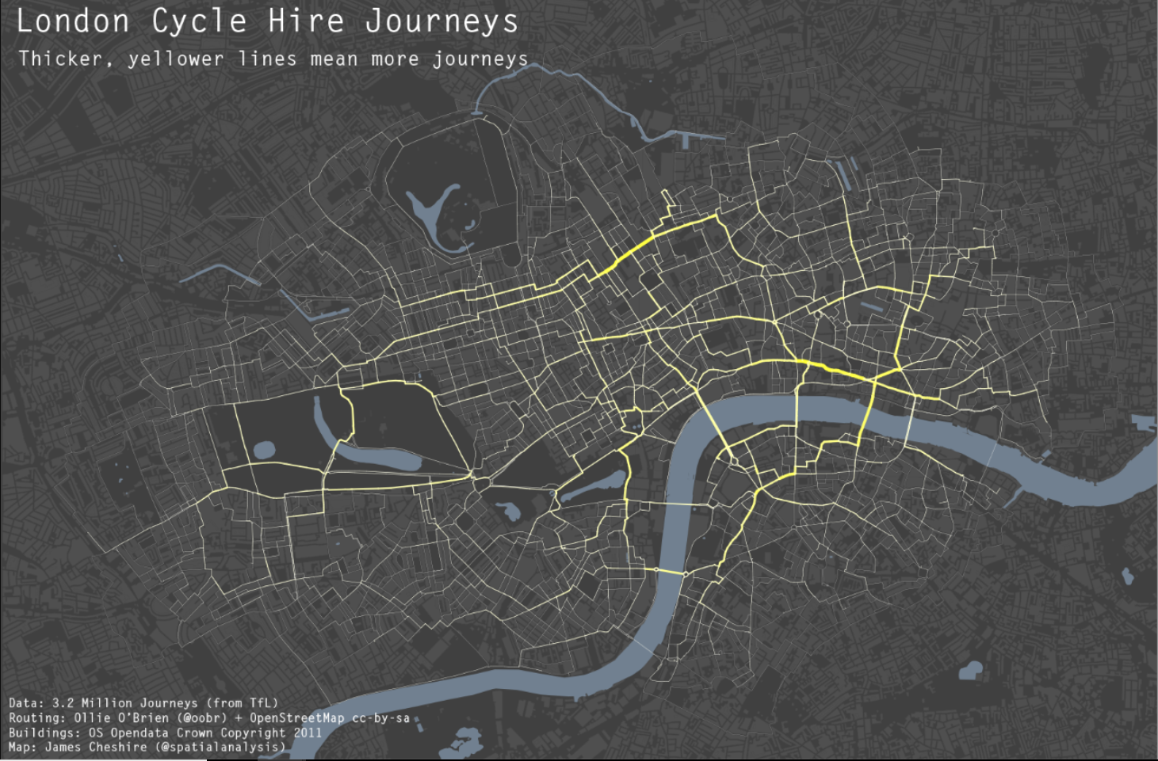
http://spatial.ly/2012/02/great-maps-ggplot2/

Slide 9
Statistics & Machine Learning ( example later )

Slide 10
Collaboration & Reproducibility

Slide 11
R Markdown

Slide 12
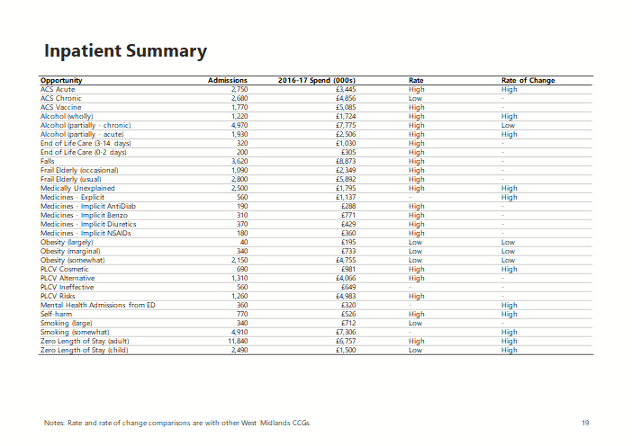
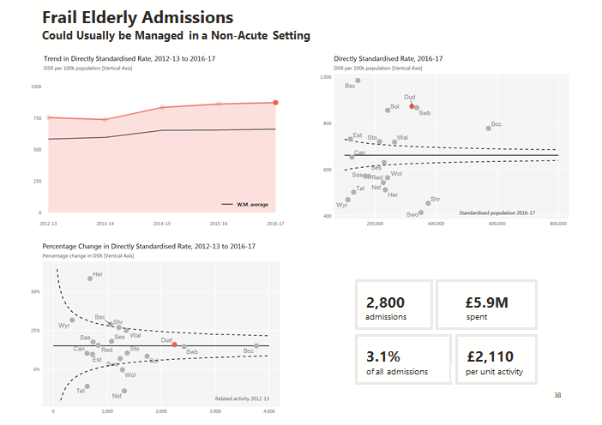
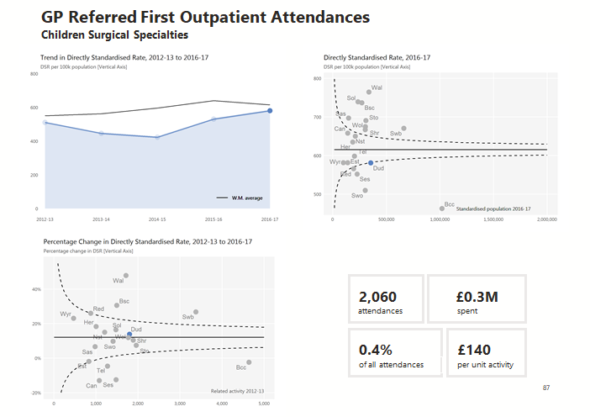
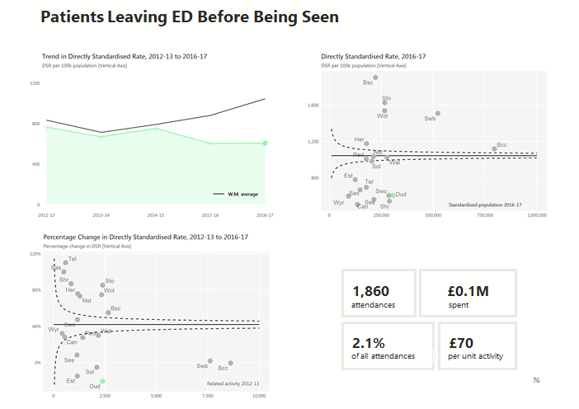
Automated reports
1800 unique graphics
100 unique tables
built into a
PowerPoint
from R

Slide 13
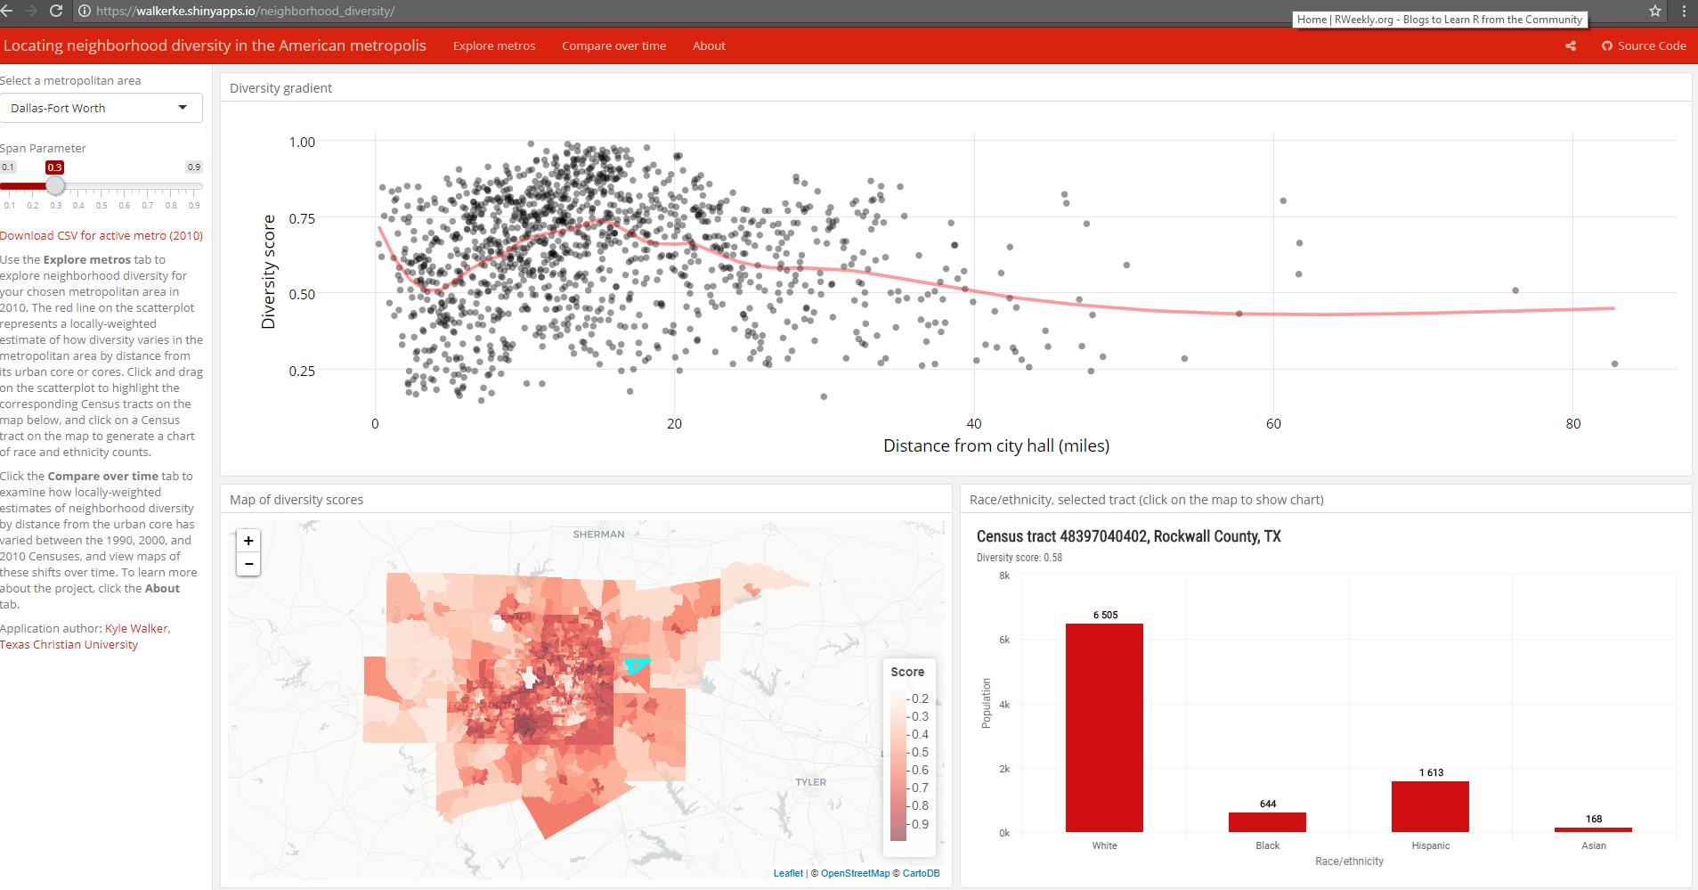
(Interactive) Dashboards
https://walkerke.shinyapps.io/neighborhood_diversity/

Slide 14
R to SQL connection

Slide 15
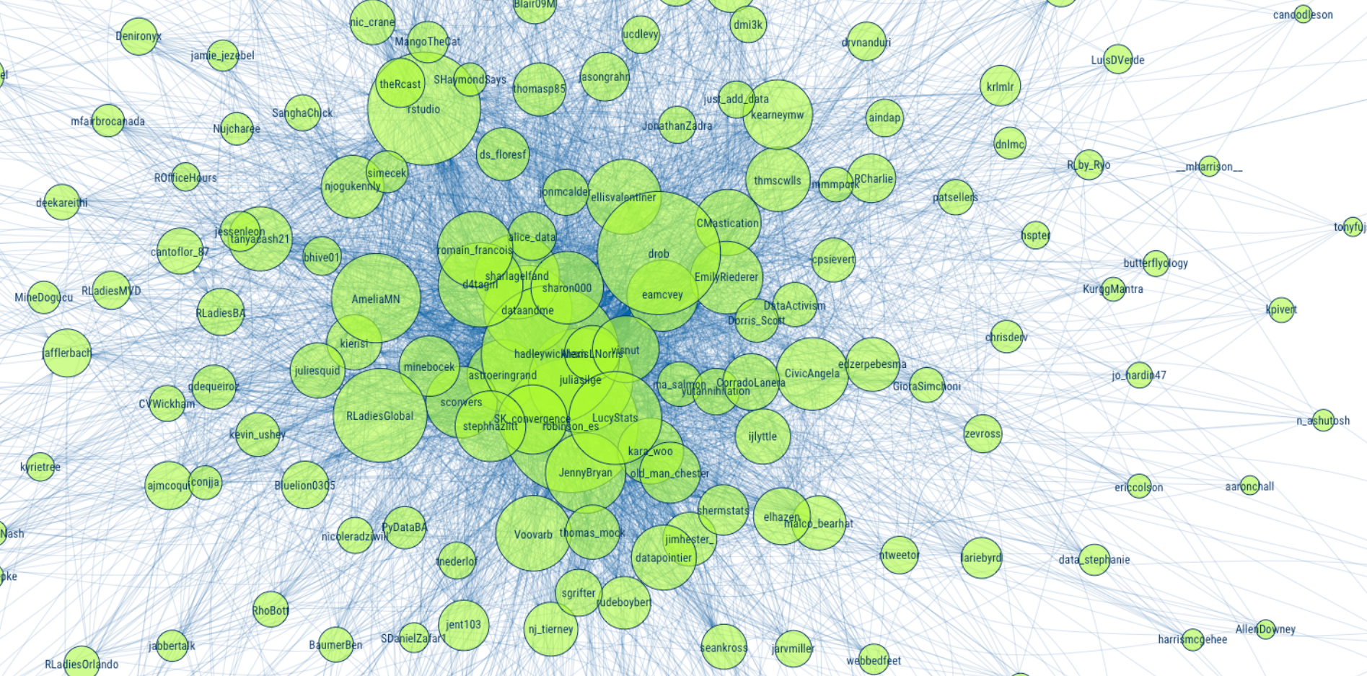
Community
https://github.com/mkearney/rstudioconf_tweets

Slide 16

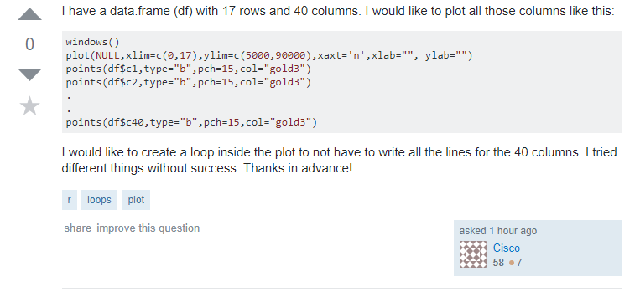
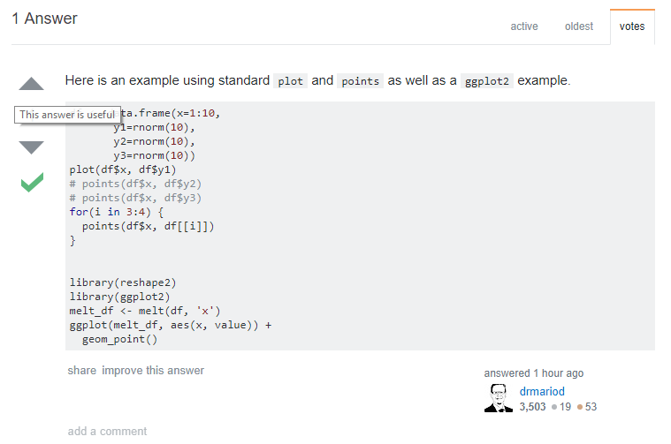

Slide 17

Inclusivity

Slide 18
Course Aims
To show you some of the possibilities.
To give you a feel for how R works.

Slide 19
Course Aims
To show you some of the possibilities.
To give you a feel for how R works.
To show you enough for you to begin teaching yourself
(Excellent free resources available)

Slide 20
Course philosophy

Slide 21
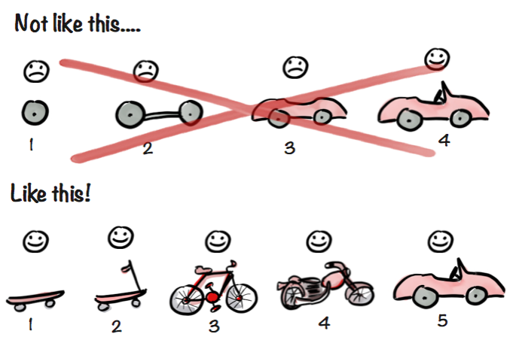
MVP Diagram
https://blog.crisp.se/2016/01/25/henrikkniberg/making-sense-of-mvp
Henrik Kniberg

Slide 22
Course philosophy
Relaxed and informal.
(Slides and code are available online)
The truth; but it can’t be the whole truth…
too much to cover in a day.

Slide 23
Let’s begin…

Slide 24
R vs. RStudio
R is a programming language
RStudio is a software application with tools to improve your programming experience

Slide 25
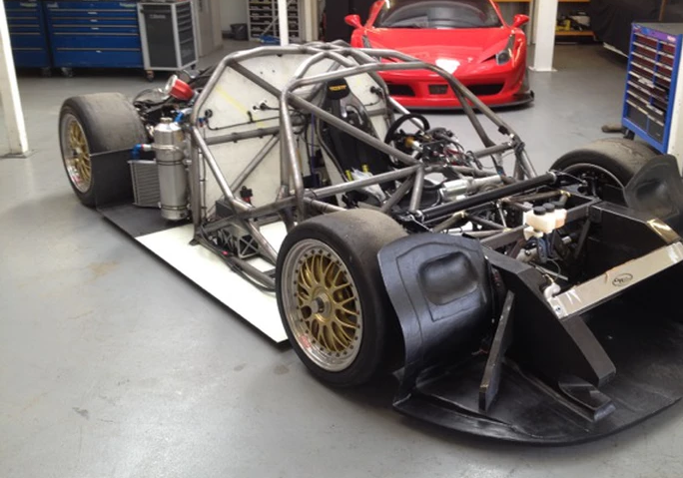
R
Credit: http://www.rollcentre.com/project--onuk-sazan-

Slide 26

RStudio
Photo by Roberto Nickson (@g) on Unsplash

Slide 27
RStudio
Many excellent features to help you with your analyses.
Never again have to think about R and RStudio as separate: Opening R-Studio opens an R session.
Analogy from the book Modern Dive: www.moderndive.com

Slide 28
Open RStudio
Opening R-Studio opens an R session.

Slide 29
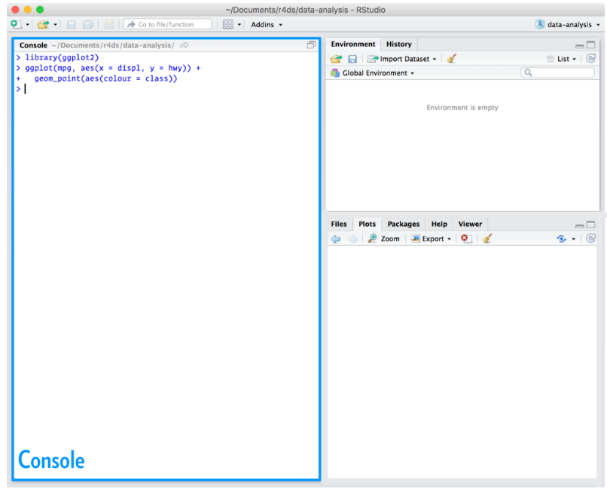
The Console is your window to R.
You can code directly in the console…
pi*2 [Enter]
37/12 [Enter]
… but there is a better way…

Slide 30
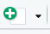
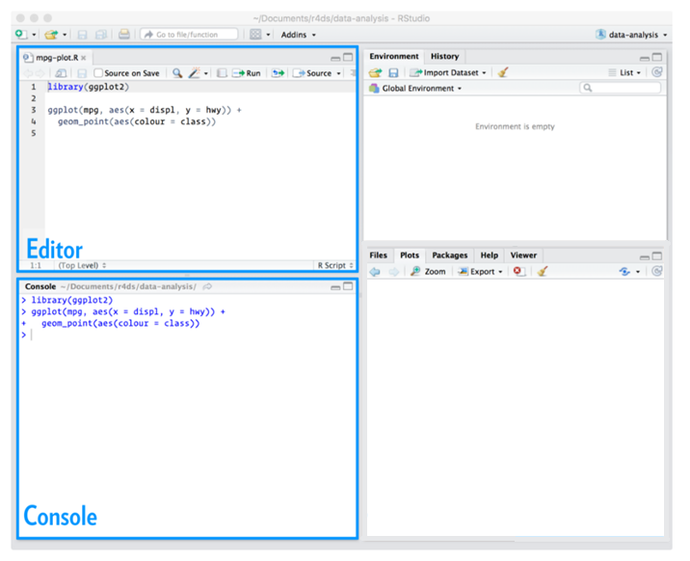
The Editor.
If you don’t see the Editor
pane, click:
And choose
“R Script” from the drop-down.
Or, shortcut:
Ctrl+ Shift+ N

Slide 31
The Editor is just like any other text editor: you can copy, paste, and save text.
More forgiving
R Syntax highlighting
Autocomplete
(use it!)
Ctrl + Enter (sends line of code to Console)

Slide 32
Comment code with a #
E.g:
# this was a bad idea
Notes:
Also note
8 Object “character string”

Slide 33
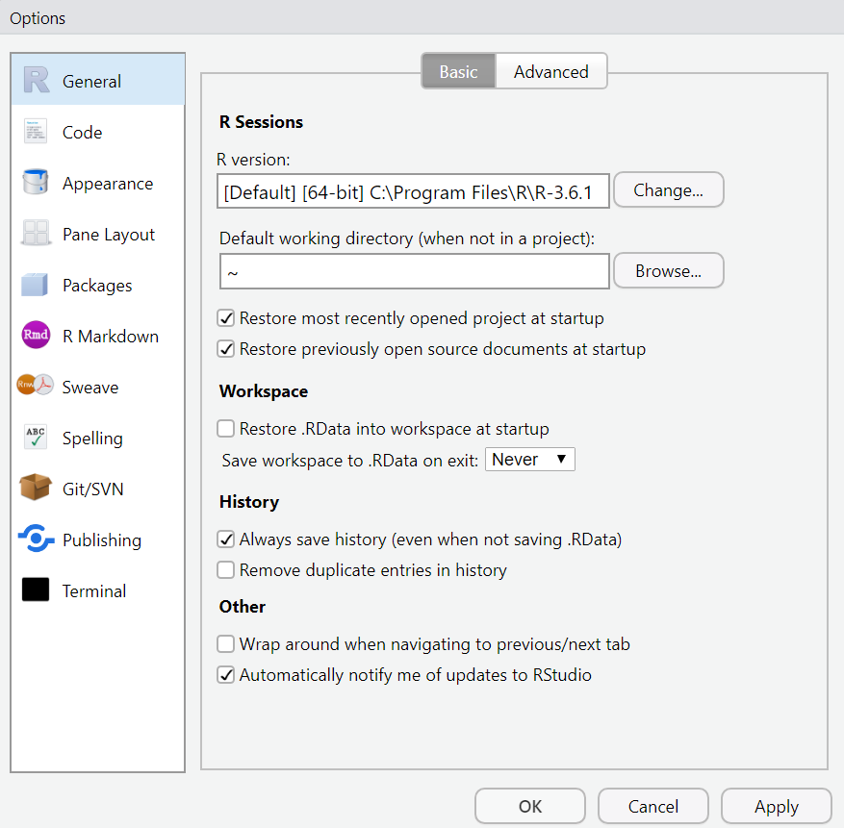
Tools → Global Options
Best practice – to ensure
reproducibility

Slide 34
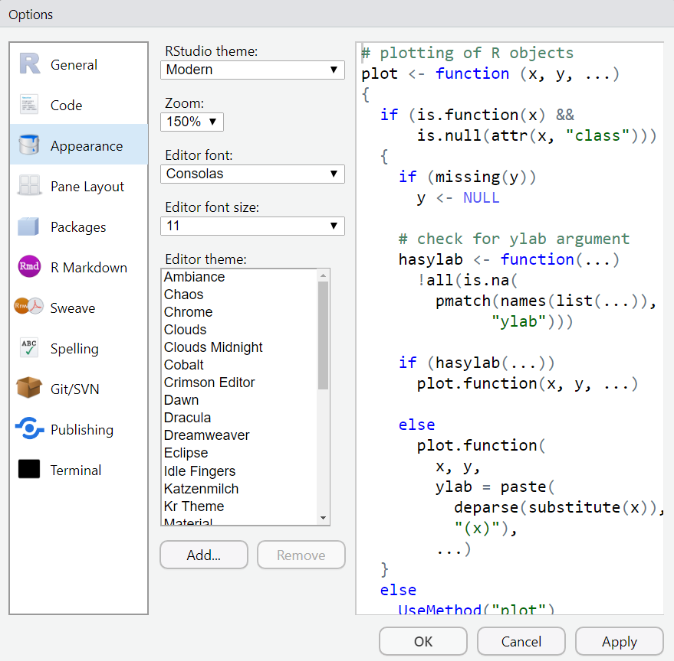
Tools → Global Options

Slide 35
Packages

Slide 36
Packages
R packages are like apps for your phone:
Extend the capabilities of the basic or “base" R
with extra functions, datasets, documentation.

Slide 37
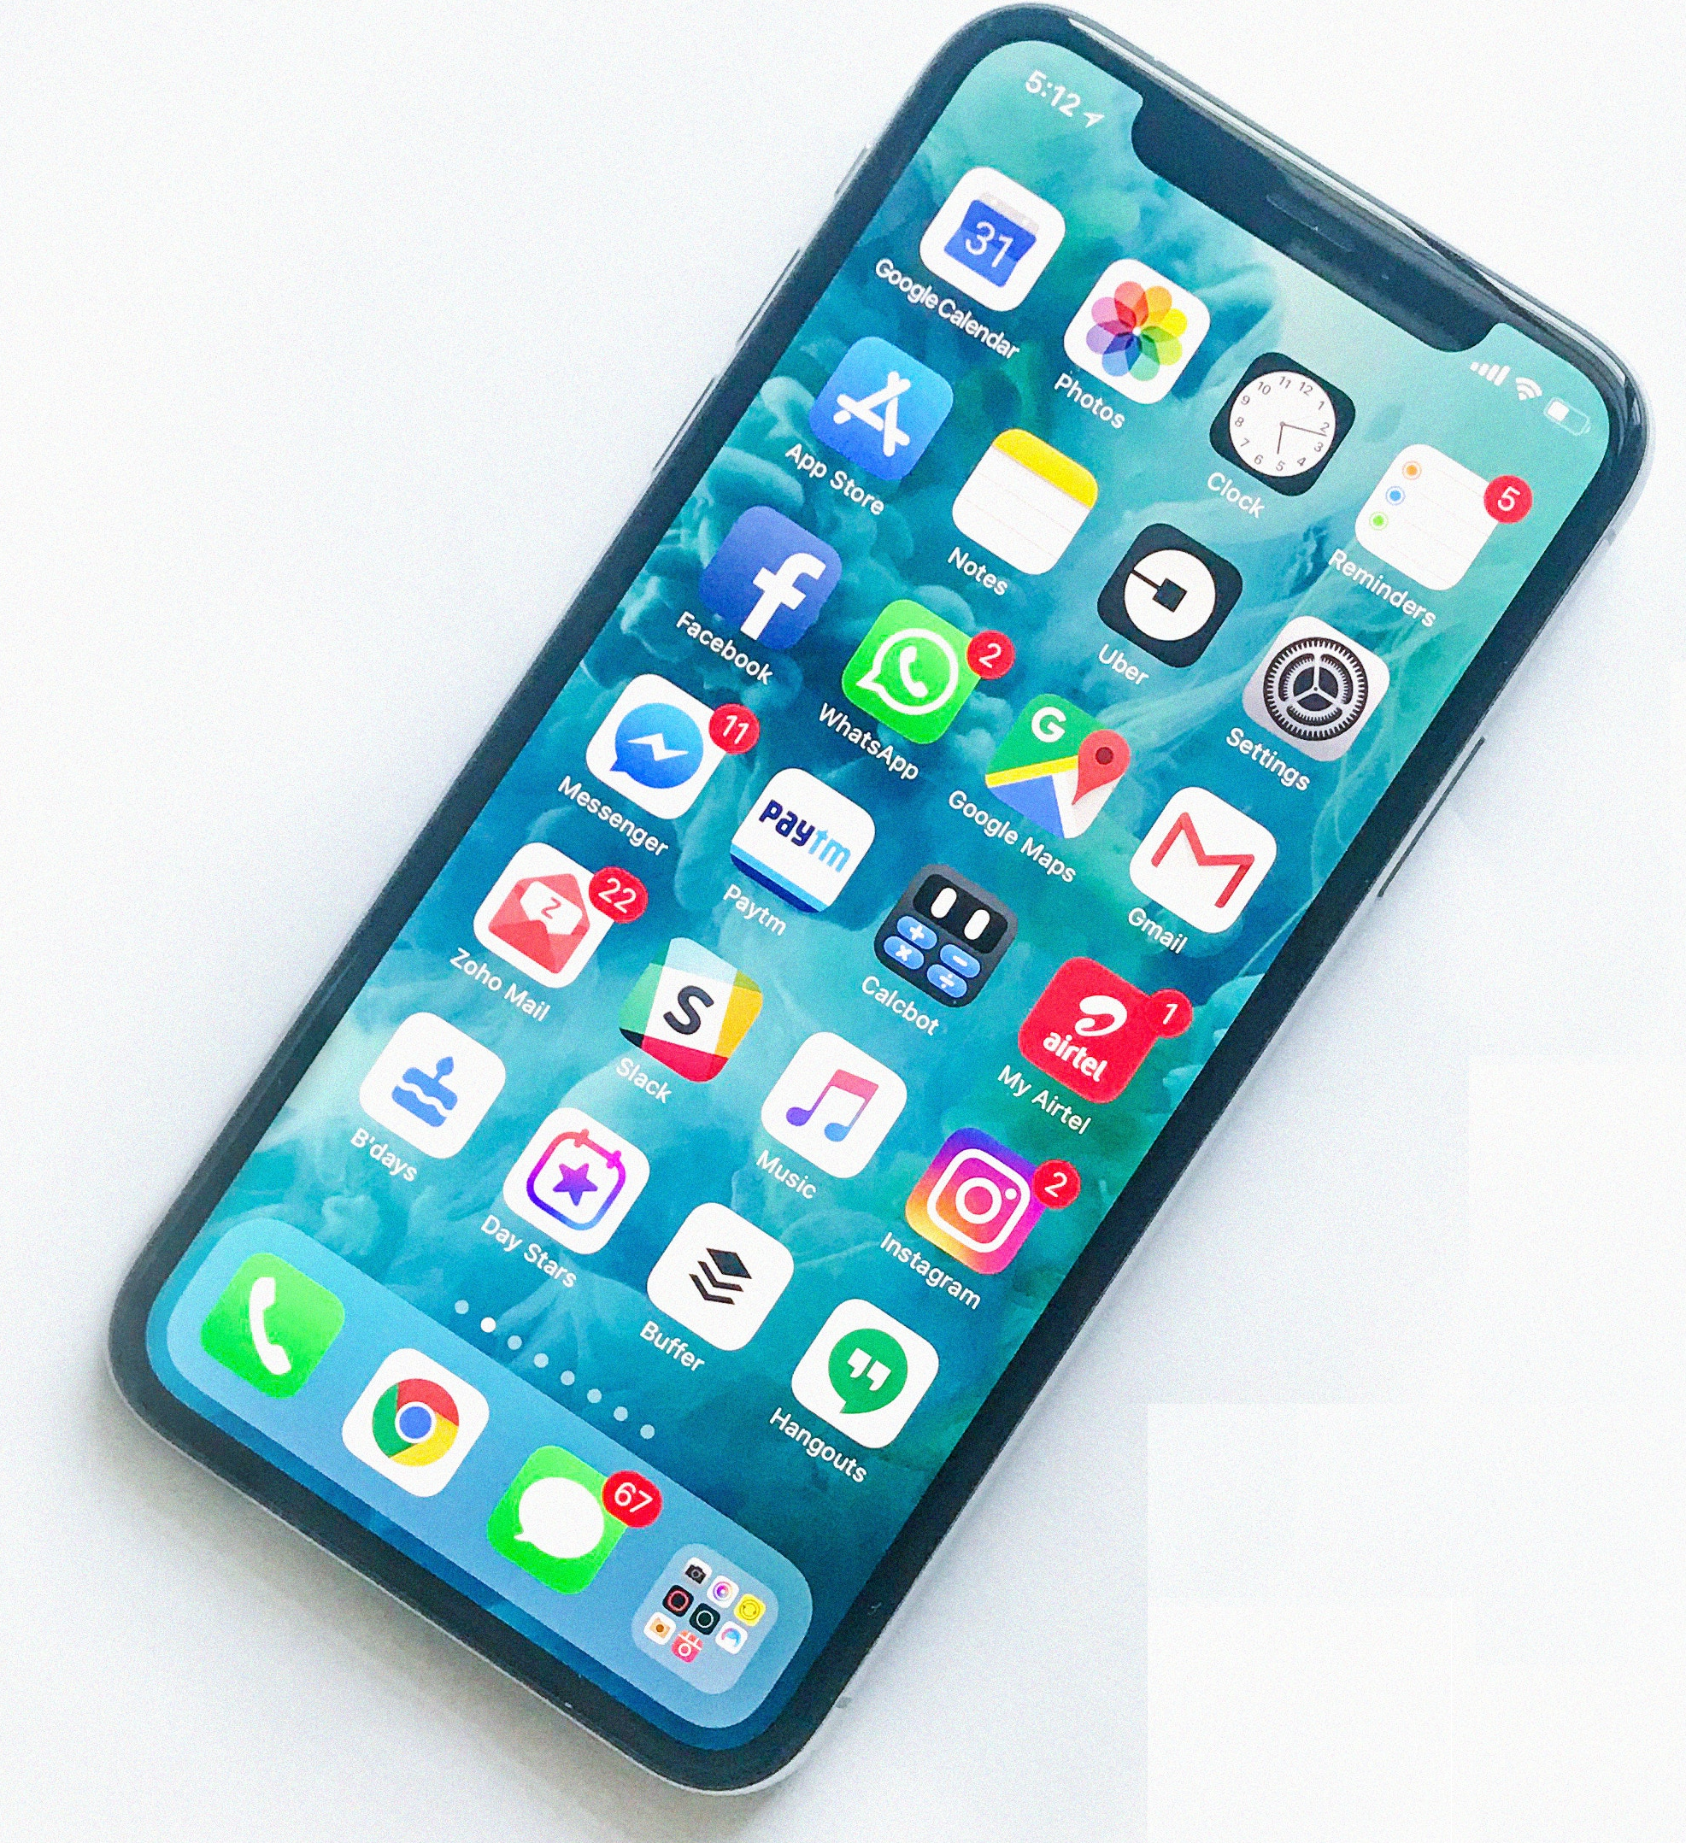

Packages
Download App
Download
(install.packages)
Phone detail from photo by Rahul Chakraborty on Unsplash
Happens
just once
Open
the App
“Open”
library()
Every new session

Slide 38
Packages
install.packages(“tidyverse”)
library(tidyverse)
will download a package to your personal library. Then:
tells R to load the tidyverse package from your personal library.
(Needed for every new session)

Slide 39
CRAN repository
14,000+ packages. Free. Peer reviewed.
(Manifold possibilities) eg. interactive graphics and dashboards, machine learning, mine twitter data, create PowerPoint docs, maps…
Other ways to get packages (eg. GitHub, …)

Slide 40
Packages: tidyverse

Slide 41
What is the tidyverse?
The tidyverse package collects (some of) the most popular R packages into one.
All have the same underlying principles:
Provide simple tools (with consistent structure) which may be used together to help solve complex problems.

Slide 42
What is the tidyverse?
During the workshop we will use the ggplot2, dplyr, and readr packages. These are bundled up in the tidyverse package. We load it by running:
library(tidyverse)

Slide 43
This material was created for the NHS-R community by:
Andrew Jones @The Strategy Unit
The work is licenced under:
Creative Commons
Attribution-ShareAlike 4.0
International
To view a copy of this license, visit
https://creativecommons.org/licenses/by-sa/4.0/

Slide 44
End

